Slide 1
Introduction to DHS CAPI system

Slide 2
The DHS CAPI System
CAPI – Computer Assisted Personal Interview
DHS System developed with the objective of helping interviewers, supervisors and the central office to collect, supervise and monitor the fieldwork operation
Written in CSPro with some utilities written in C# and HTML
Uses internet to transfer data to central office
Internet File Streaming System (IFSS)
SyncCloud
CSWeb
Uses Bluetooth to share data among members of the fieldwork team
Three modules/sub-systems defined
Interviewer data collection
Supervisor tracking of data being collected by the team
Central Office
Notes:
At DHS we define a CAPI operation as a

Slide 3
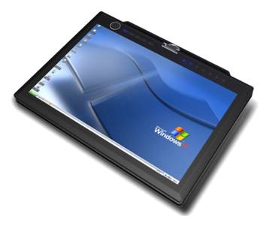


Int 2
Int 5
Repair/upgrades
Interviewer’s System
Updates, Data Sharing &
Transfer to supervisor
Supervisor’s System
Screen
Reports
Supervisor
Supervisor
Data Transfer & Updates
Central Office System
Reports
Central Office

Slide 4
CAPI Supporting Files
In preparation before the data collection begins with the CAPI system, it is necessary to have the following three auxiliary files:
CLUSTERS.DAT – File with one record for every Cluster (PSU) selected for the sample
Includes all geographical variables related to the cluster
Any subsampling at the cluster level
Notes:
This file allows to make sure that geographical variables are correctly assigned to the questionnaires
May contain the number of households in a cluster based on census data
Can be used for household listing purposes
Used to assign geographical variables needed for the data files

Slide 5
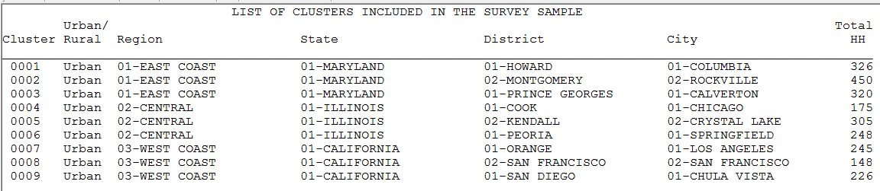
Clusters

Slide 6
CAPI Supporting Files
INTERV.DAT – File with one record for every member of the fieldwork operation
Interviewers
Supervisors
Health specialists
Team that they belong to
Gender of the fieldworker
Notes:
In this file all fieldwork personnel participating in the survey are registered with related information (code, name, team, role, sex).

Slide 7
Fieldwork Personnel

Slide 8
CAPI Supporting Files
SAMPSEL.DAT – File with one record for every household selected in each cluster selected for the survey
It allows a strict control for each household to be interviewed.
It guaranties that the sample is properly met
Used by supervisors to assign households to interviewers in each cluster
It contains the address of the household in the cluster, the name of the head of the household and the structure number in some cases
It contains all subsampling selection needed for the overall sample

Slide 9
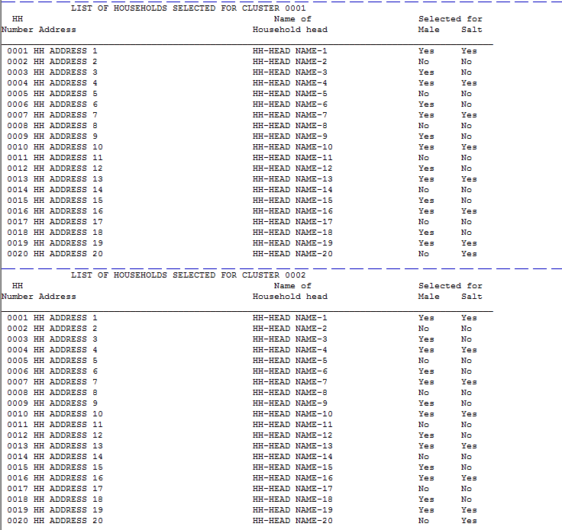
Households Selected in Clusters

Slide 10
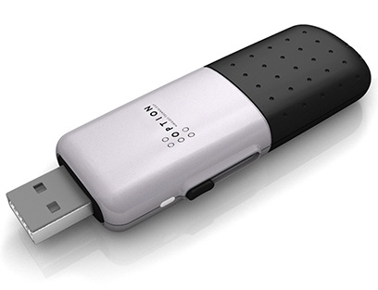

Interviewers System Components
Menu application
Household interview
Individual interview
Entering biomarkers
List households and individuals in the cluster
Eligible women and children in a household
Backup to flash memory devices
Transfer data to supervisors/sharing data with the team
Ability to modify identifiers
Get updates from supervisor
Backups
Int1
Int2
Int5
Repair Transfer Utilities
Update Transfer Utilities
Supervisor

Slide 11

Supervisor System Components
I1
I2
Menu application
Assign households to interviewers
Receives data from interviewers daily
Keeps track of status for every household
Checks data structure
Report overall summaries for the cluster
Options for remeasurement
Options to enter vac from health facilities
Send to central office using IFSS
Get and distribute system updates
Backup data to flash memory devices
Enter barcodes from transmittal sheets
Upgrades
Send/Receive Data
Backup
Internet - GPRS
Central Office

Slide 12
Fieldwork Flow
Arrive in cluster, Identify households
Interviewers carry out women interviews, enter biomarker data
Supervisor assigns households to interviewers
Interviewers send data to supervisor
Interviewers interview HHs, identify eligible individuals
Supervisor runs check to close cluster
Interviewers send data to supervisor
Supervisor carries out remeasurement
Health Specialists collect height & weight
Supervisor submits data to central office

Slide 13
Central Office System Components
Menu Application
Receive clusters from supervisors via internet
Reports & structure checking by cluster
Run secondary editing programs by cluster and modify errors
Run field check tables
Monitor fieldwork operation by cluster or supervisor
Review interviewer notes for cluster
Supervisor 1
Supervisor 2
Supervisor n

Slide 14
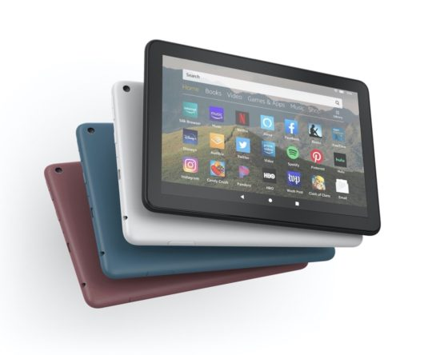
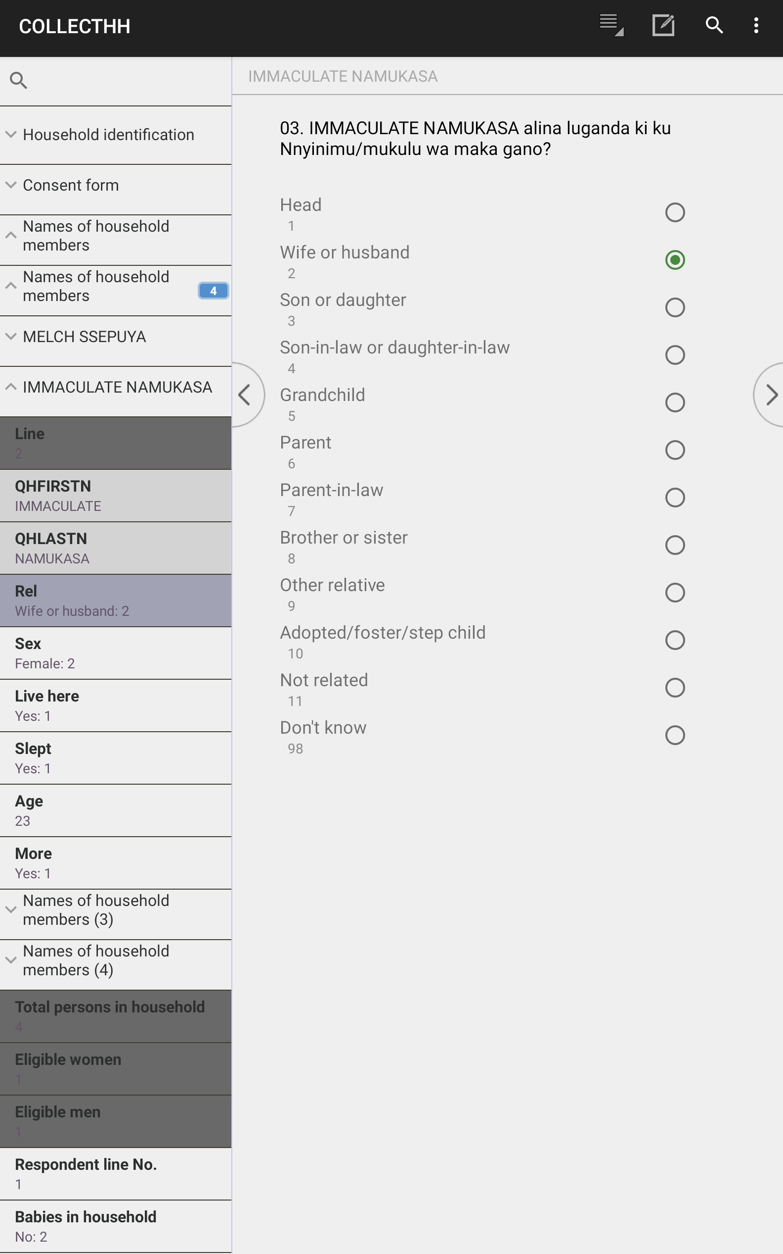
New Developments – using Android devices
Pros:
Lower cost
Low cost Windows tablets are dying out
Better for GPS and photographs
Easier to use
Cons
Limited to one or few questions per screen
More complicated to program

Slide 15
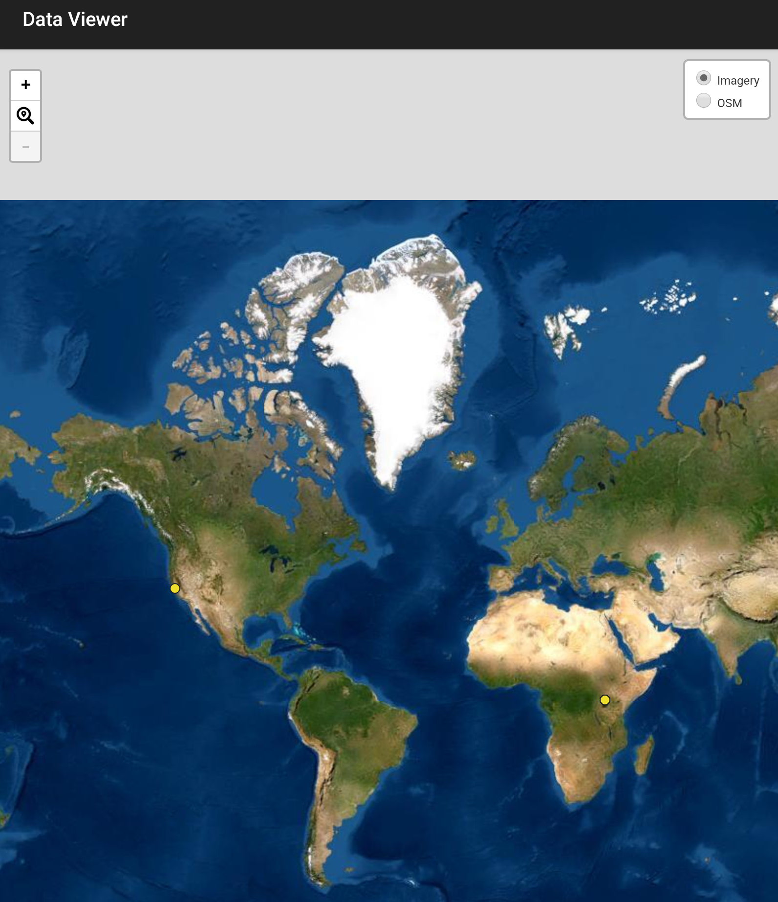
New Developments – using GPS
Require interviewers to take GPS reading for each interview
Reduce /discourage kerbstoning
Check listed households are interviewed
Also exploring use of GPS to assist in finding households

Slide 16
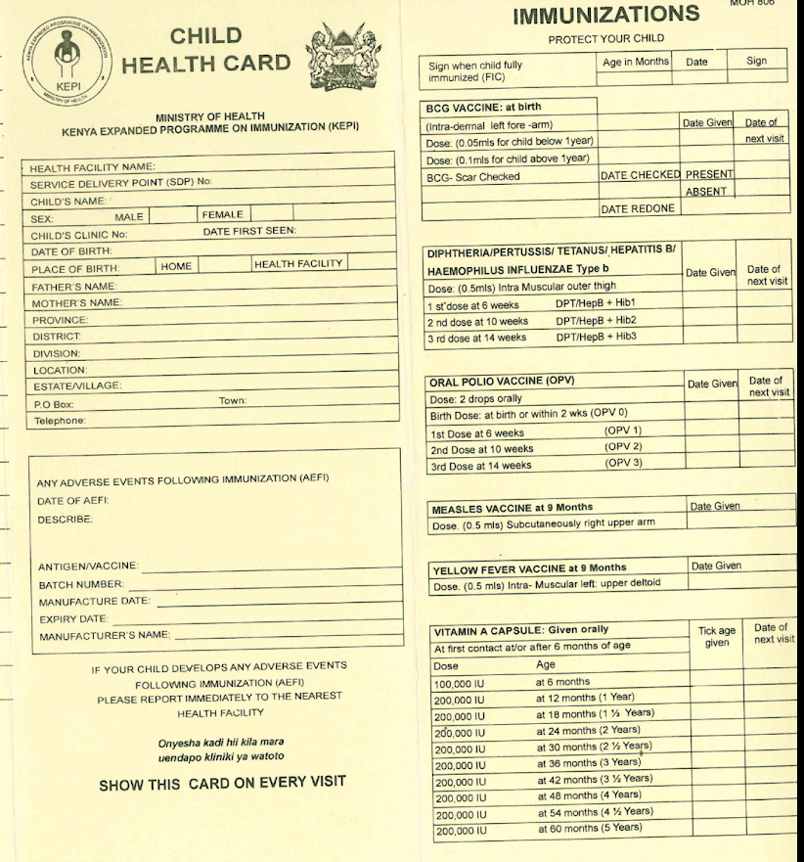
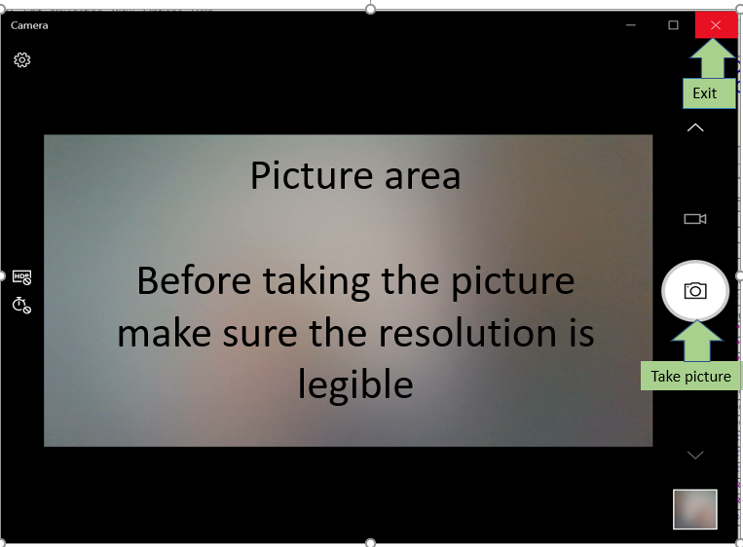
New Developments – using photos
Photograph vaccination cards to allow checking of entered data against photos
Used in South Africa DHS

Slide 17

New Developments – recording
Recording small portions of interviews
Random selection for key questions
“Silent” recording
Objectives:
Discourage kerbstoning
Encourage good interviewing practice
Possibly assist with secondary editing
Verify informed consent statements being read
-

Slide 18

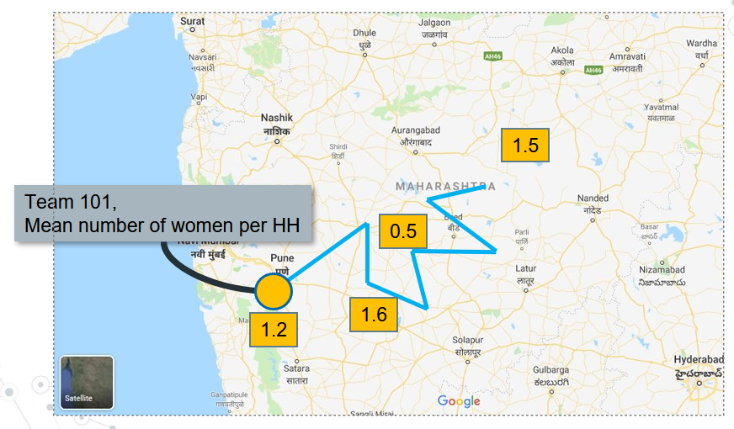
New Developments – SyncCloud
Data transfer system
Provides state of the art real-time data analysis from field
Field check data quality indicators available online accessible by browser / phone
Powerful future applications such as mapping data quality indicators
-

